Slide 1
HEART FAILURE
PRESENTING PROBLEMS IN CARDIOVASCULAR DISEASE

Slide 2
Heart failure describes the clinical syndrome that develops when the heart cannot maintain an adequate cardiac output, or can do so only at the expense of an elevated filling pressure.

Slide 3
In mild to moderate forms of heart failure, cardiac output is adequate at rest and only becomes inadequate when the metabolic demand increases during exercise or some other form of stress.
In practice, heart failure may be diagnosed whenever a patient with significant heart disease develops the signs or symptoms of a low cardiac output, pulmonary congestion or systemic venous congestion.

Slide 4
Almost all forms of heart disease can lead to heart failure.
An accurate aetiological diagnosis is important because in some situations a specific remedy may be available.

Slide 5
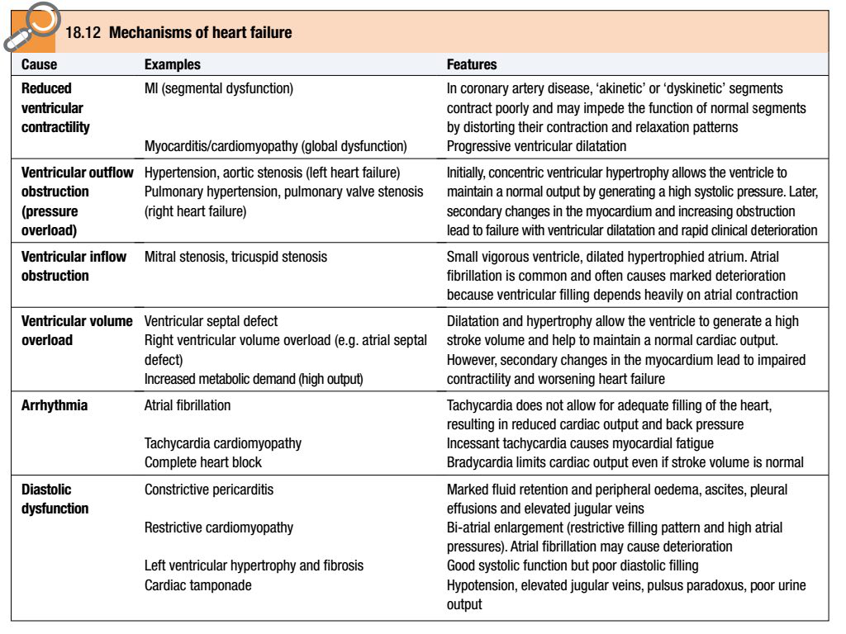

Slide 6
Heart failure is frequently due to coronary artery disease, tends to affect elderly people and often leads to prolonged disability.
The prevalence of heart failure rises from 1% in those aged 50–59 years to over 10% in those aged 80–89 years. In the UK, most patients admitted to hospital with heart failure are > 70 years old and remain hospitalised for a week or more.

Slide 7
Although the outlook depends to some extent on the underlying cause of the problem, heart failure carries a very poor prognosis; approximately 50% of patients with severe heart failure due to left ventricular dysfunction will die within 2 years.
Many patients die suddenly from malignant ventricular arrhythmias or MI.

Slide 8
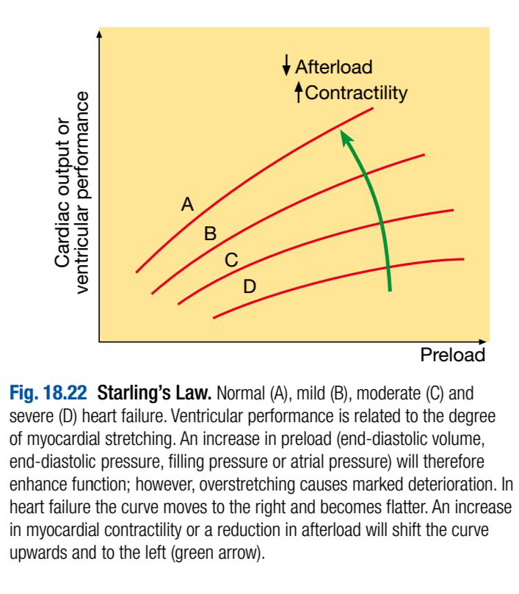
:Pathophysiology
Cardiac output is a function of the preload (the volume and pressure of blood in the ventricle at the end of diastole), the afterload (the volume and pressure of blood in the ventricle during systole) and myocardial contractility; this is the basis of Starling’s Law.

Slide 9
In patients without valvular disease, the primary abnormality is impairment of ventricular function leading to a fall in cardiac output.
This activates counter-regulatory neurohumoral mechanisms that in normal physiological circumstances would support cardiac function, but in the setting of impaired ventricular function can lead to a deleterious increase in both afterload and preload.

Slide 10
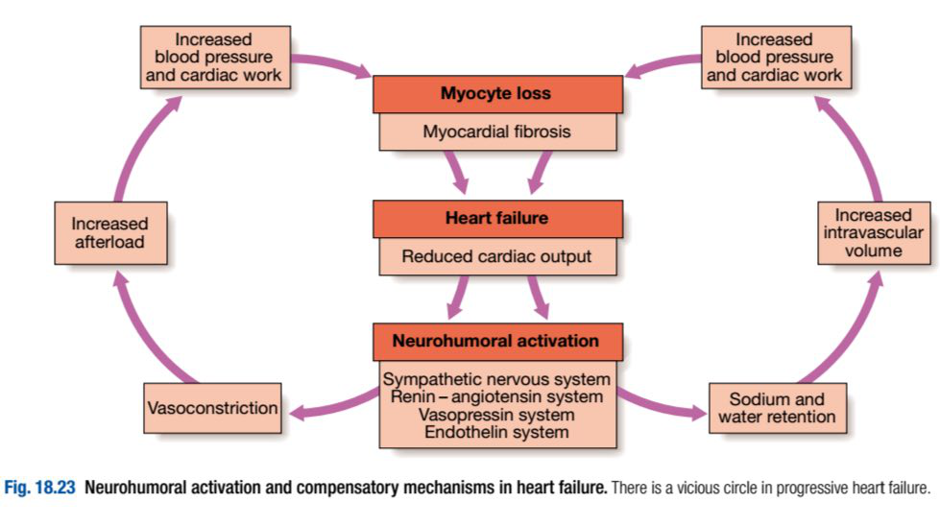

Slide 11
A vicious circle may be established because any additional fall in cardiac output will cause further neurohumoral activation and increasing peripheral vascular resistance.
Stimulation of the renin–angiotensin–aldosterone system leads to vasoconstriction, salt and water retention, and sympathetic nervous system activation.

Slide 12
This is mediated by angiotensin II, a potent constrictor of arterioles in both the kidney and the systemic circulation.
Activation of the sympathetic nervous system may initially maintain cardiac output through an increase in myocardial contractility, heart rate and peripheral vasoconstriction.

Slide 13
However, prolonged sympathetic stimulation leads to cardiac myocyte apoptosis, hypertrophy and focal myocardial necrosis.

Slide 14
Salt and water retention is promoted by the release of aldosterone, endothelin-1 (a potent vasoconstrictor peptide with marked effects on the renal vasculature) and, in severe heart failure, antidiuretic hormone (ADH).

Slide 15
Natriuretic peptides are released from the atria in response to atrial stretch, and act as physiological antagonists to the fluidconserving effect of aldosterone.

Slide 16
After MI, cardiac contractility is impaired and neurohumoral activation causes hypertrophy of non-infarcted segments, with thinning, dilatation and expansion of the infarcted segment (remodelling).
This leads to further deterioration in ventricular function and worsening heart failure.

Slide 17
The onset of pulmonary and peripheral oedema is due to high atrial pressures compounded by salt and water retention caused by impaired renal perfusion and secondary hyperaldosteronism.

Slide 18
Types of heart failure:
-Left, right and biventricular heart failure:
The left side of the heart comprises the functional unit of the LA and LV, together with the mitral and aortic valves; the right heart comprises the RA, RV, and tricuspid and pulmonary valves.

Slide 19
Left-sided heart failure: There is a reduction in the left ventricular output and an increase in the left atrial or pulmonary venous pressure. An acute increase in left atrial pressure causes pulmonary congestion or pulmonary oedema; a more gradual increase in left atrial pressure, as occurs with mitral stenosis, leads to reflex pulmonary vasoconstriction, which protects the patient from pulmonary oedema at the cost of increasing pulmonary hypertension.

Slide 20
Right-sided heart failure: There is a reduction in right ventricular output for any given right atrial pressure. Causes of isolated right heart failure include chronic lung disease (cor pulmonale), multiple pulmonary emboli and pulmonary valvular stenosis.

Slide 21
Biventricular heart failure: Failure of the left and right heart may develop because the disease process, such as dilated cardiomyopathy or ischaemic heart disease, affects both ventricles or because disease of the left heart leads to chronic elevation of the left atrial pressure, pulmonary hypertension and right heart failure.

Slide 22
-Diastolic and systolic dysfunction:
Heart failure may develop as a result of impaired myocardial contraction (systolic dysfunction) but can also be due to poor ventricular filling and high filling pressures caused by abnormal ventricular relaxation (diastolic dysfunction).
The latter is caused by a stiff non-compliant ventricle and is commonly found in patients with left ventricular hypertrophy.
Systolic and diastolic dysfunction often coexist, particularly in patients with coronary artery disease.

Slide 23
-High-output failure:
Conditions such as large arteriovenous shunt, beri-beri, severe anaemia or thyrotoxicosis can occasionally cause heart failure due to an excessively high cardiac output.

Slide 24
-Acute and chronic heart failure:
Heart failure may develop suddenly, as in MI, or gradually, as in progressive valvular heart disease.
When there is gradual impairment of cardiac function, a variety of compensatory changes may take place.

Slide 25
The term ‘compensated heart failure’ is sometimes used to describe those with impaired cardiac function in whom adaptive changes have prevented the development of overt heart failure.
A minor event, such as an intercurrent infection or development of atrial fibrillation, may precipitate overt or acute heart failure.

Slide 26
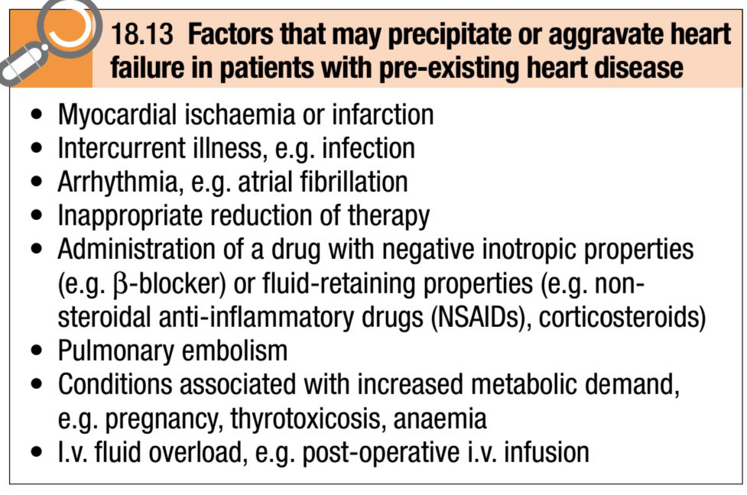

Slide 27
Acute left heart failure occurs either de novo or as an acute decompensated episode on a background of chronic heart failure, so-called acute-on-chronic heart failure.

Slide 28
Clinical assessment:
Acute left heart failure:
Acute de novo left ventricular failure presents with a sudden onset of dyspnoea at rest that rapidly progresses to acute respiratory distress, orthopnoea and prostration.

Slide 29
The precipitant, such as acute MI, is often apparent from the history.
The patient appears agitated, pale and clammy.
The peripheries are cool to the touch and the pulse is rapid.

Slide 30
Inappropriate bradycardia or excessive tachycardia should be identified promptly, as this may be the precipitant for the acute episode of heart failure.
The BP is usually high because of sympathetic nervous system activation, but may be normal or low if the patient is in cardiogenic shock.

Slide 31
The jugular venous pressure (JVP) is usually elevated, particularly with associated fluid overload or right heart failure.
In acute de novo heart failure, there has been no time for ventricular dilatation and the apex is not displaced.

Slide 32
Auscultation occasionally identifies the murmur of a catastrophic valvular or septal rupture, or reveals a triple ‘gallop’ rhythm.
Crepitations are heard at the lung bases, consistent with pulmonary oedema.

Slide 33
Acute-on-chronic heart failure will have additional features of long-standing heart failure.
Potential precipitants, such as an upper respiratory tract infection or inappropriate cessation of diuretic medication, should be identified.

Slide 34
Chronic heart failure:
Patients with chronic heart failure commonly follow a relapsing and remitting course, with periods of stability and episodes of decompensation leading to worsening symptoms that may necessitate hospitalisation.

Slide 35
The clinical picture depends on the nature of the underlying heart disease, the type of heart failure that it has evoked, and the neurohumoral changes that have developed.

Slide 36
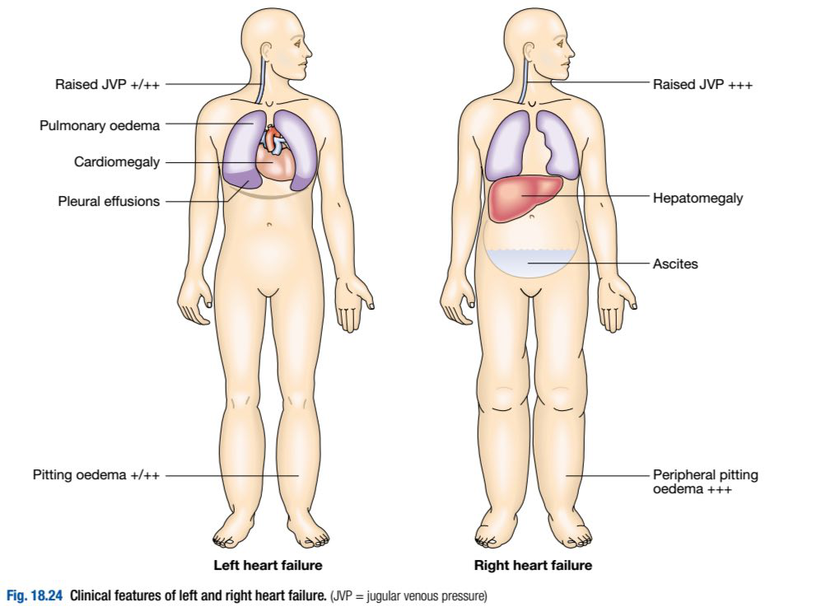

Slide 37
A low cardiac output causes fatigue, listlessness and a poor effort tolerance; the peripheries are cold and the BP is low.
To maintain perfusion of vital organs, blood flow is diverted away from skeletal muscle and this may contribute to fatigue and weakness.

Slide 38
Poor renal perfusion leads to oliguria and uraemia.
Pulmonary oedema due to left heart failure presents as described above and with inspiratory crepitations over the lung bases.
In contrast, right heart failure produces a high JVP with hepatic congestion and dependent peripheral oedema.

Slide 39
In ambulant patients, the oedema affects the ankles, whereas in bed-bound patients it collects around the thighs and sacrum.
Ascites or pleural effusion occurs in some cases.
Heart failure is not the only cause of oedema.

Slide 40
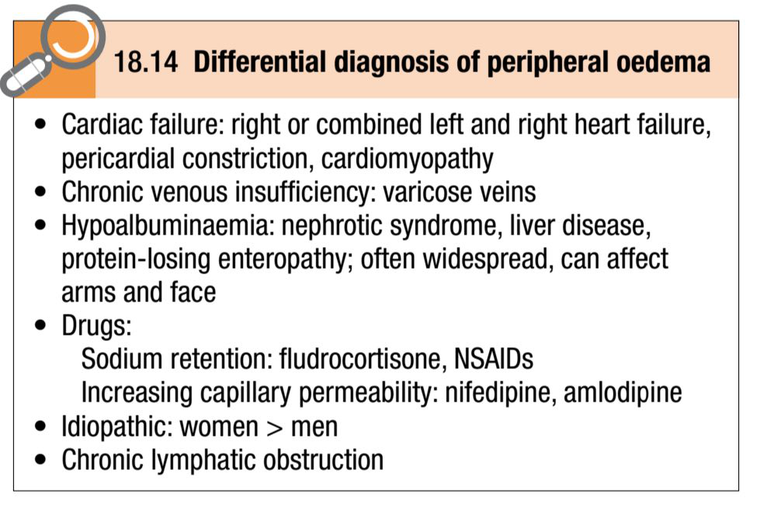

Slide 41
Chronic heart failure is sometimes associated with marked weight loss (cardiac cachexia) caused by a combination of anorexia and impaired absorption due to gastrointestinal congestion, poor tissue perfusion due to a low cardiac output, and skeletal muscle atrophy due to immobility.

Slide 42
Complications:
In advanced heart failure, the following may occur:
A- Renal failure is caused by poor renal perfusion due to a low cardiac output and may be exacerbated by diuretic therapy, angiotensin-converting enzyme (ACE) inhibitors and angiotensin receptor blockers.

Slide 43
B- Hypokalaemia may be the result of treatment with potassium-losing diuretics or hyperaldosteronism caused by activation of the renin–angiotensin system and impaired aldosterone metabolism due to hepatic congestion. Most of the body’s potassium is intracellular and there may be substantial depletion of potassium stores, even when the plasma potassium concentration is in the normal range.

Slide 44
C- Hyperkalaemia may be due to the effects of drug treatment, particularly the combination of ACE inhibitors and spironolactone (which both promote potassium retention), and renal dysfunction.

Slide 45
D- Hyponatraemia is a feature of severe heart failure and is a poor prognostic sign. It may be caused by diuretic therapy, inappropriate water retention due to high ADH secretion, or failure of the cell membrane ion pump.

Slide 46
E- Impaired liver function is caused by hepatic venous congestion and poor arterial perfusion, which frequently cause mild jaundice and abnormal liver function tests; reduced synthesis of clotting factors can make anticoagulant control difficult.

Slide 47
F- Thromboembolism: Deep vein thrombosis and pulmonary embolism may occur due to the effects of a low cardiac output and enforced immobility, whereas systemic emboli may be related to arrhythmias, atrial flutter or fibrillation, or intracardiac thrombus complicating conditions such as mitral stenosis, MI or left ventricular aneurysm.

Slide 48
G- Atrial and ventricular arrhythmias are very common and may be related to electrolyte changes (e.g. hypokalaemia, hypomagnesaemia), the underlying structural heart disease, and the pro-arrhythmic effects of increased circulating catecholamines or drugs. Sudden death occurs in up to 50% of patients with heart failure and is often due to a ventricular arrhythmia. Frequent ventricular ectopic beats and runs of non-sustained ventricular tachycardia are common findings in patients with heart failure and are associated with an adverse prognosis.

Slide 49
Investigations:
Serum urea and electrolytes, haemoglobin, thyroid function, ECG and chest X-ray may help to establish the nature and severity of the underlying heart disease and detect any complications.

Slide 50
Brain natriuretic peptide (BNP) is elevated in heart failure and is a marker of risk; it is useful in the investigation of patients with breathlessness or peripheral oedema.

Slide 51
Echocardiography is very useful and should be considered in all patients with heart failure in order to:
-determine the aetiology
-detect hitherto unsuspected valvular heart disease, such as occult mitral stenosis, and other conditions that may be amenable to specific remedies
- identify patients who will benefit from long-term therapy with drugs, such as ACE inhibitors.

Slide 52
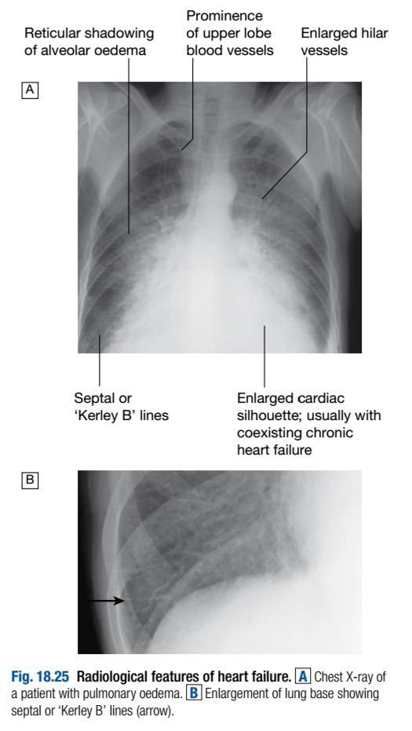
Chest X-ray
A rise in pulmonary venous pressure from left-sided heart failure first shows on the chest X-ray as an abnormal distension of the upper lobe pulmonary veins (with the patient in the erect position).

Slide 53
The vascularity of the lung fields becomes more prominent, and the right and left pulmonary arteries dilate.
Subsequently, interstitial oedema causes thickened interlobular septa and dilated lymphatics.

Slide 54
These are evident as horizontal lines in the costophrenic angles (septal or ‘Kerley B’ lines).
More advanced changes due to alveolar oedema cause a hazy opacification spreading from the hilar regions, and pleural effusions.

Slide 55
Management of acute pulmonary
:oedema
This is urgent:
Sit the patient up in order to reduce pulmonary congestion.
Give oxygen (high-flow, high-concentration). Noninvasive positive pressure ventilation (continuous positive airways pressure (CPAP) of 5–10mmHg) by a tight-fitting facemask results in a more rapid improvement in the patient’s clinical state.

Slide 56
Administer nitrates, such as i.v. glyceryl trinitrate 10–200 μg/min or buccal glyceryl trinitrate 2–5mg, titrated upwards every 10 minutes, until clinical improvement occurs or systolic BP falls to < 110 mmHg.
Administer a loop diuretic such as furosemide 50–100mg i.v.

Slide 57
The patient should initially be kept on strict bed rest with continuous monitoring of cardiac rhythm, BP and pulse oximetry.
Intravenous opiates may be cautiously used when patients are in extremis. They reduce sympathetically mediated peripheral vasoconstriction but may cause respiratory depression and exacerbation of hypoxaemia and hypercapnia.

Slide 58
If these measures prove ineffective, inotropic agents may be required to augment cardiac output, particularly in hypotensive patients. Insertion of an intra-aortic balloon pump can be very beneficial in patients with acute cardiogenic pulmonary oedema, especially when secondary to myocardial ischaemia.

Slide 59
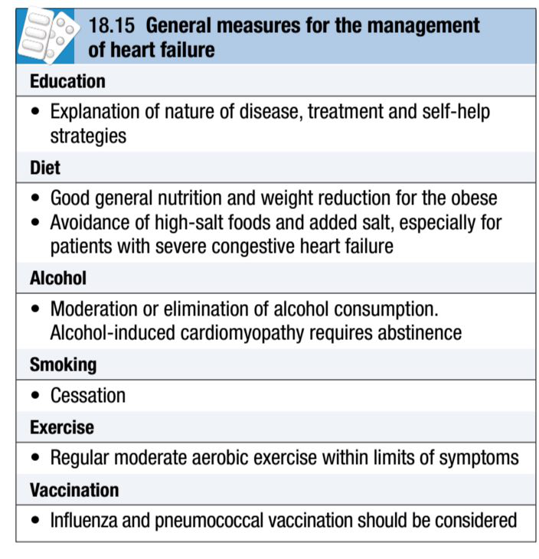
Management of chronic :heart failure
General measures:
Education of patients and their relatives about the causes and treatment of heart failure can help adherence to a management plan:

Slide 60
Some patients may need to weigh themselves daily and adjust their diuretic therapy accordingly.
In patients with coronary heart disease, secondary preventative measures, such as low-dose aspirin and lipid-lowering therapy, are required.
However, statins do not appear to be effective in patients with severe heart failure.

Slide 61
Drug therapy:
Cardiac function can be improved by increasing contractility, optimising preload or decreasing afterload.
Drugs that reduce preload are appropriate in patients with high end-diastolic filling pressures and evidence of pulmonary or systemic venous congestion.

Slide 62
Those that reduce afterload or increase myocardial contractility are more useful in patients with signs and symptoms of a low cardiac output.

Slide 63
Diuretic therapy:
In heart failure, diuretics produce an increase in urinary sodium and water excretion, leading to a reduction in blood and plasma volume.
Diuretic therapy reduces preload and improves pulmonary and systemic venous congestion.

Slide 64
It may also reduce afterload and ventricular volume, leading to a fall in wall tension and increased cardiac efficiency.
Although a fall in preload (ventricular filling pressure) tends to reduce cardiac output, the ‘Starling curve’ in heart failure is flat, so there may be a substantial and beneficial fall in filling pressure with little change in cardiac output.

Slide 65
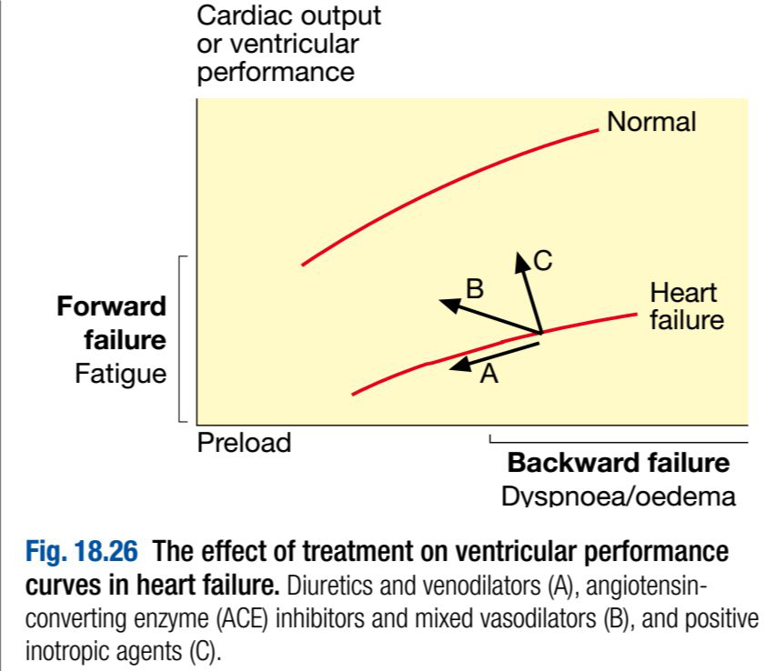

Slide 66
Nevertheless, excessive diuretic therapy may cause an undesirable fall in cardiac output, with a rising serum urea, hypotension and increasing lethargy, especially in patients with a marked diastolic component to their heart failure.

Slide 67
In some patients with severe chronic heart failure, particularly in the presence of chronic renal impairment, oedema may persist despite oral loop diuretics. In such patients an intravenous infusion of furosemide 10mg/hr may initiate a diuresis.

Slide 68
Combining a loop diuretic with a thiazide (e.g. bendroflumethiazide 5mg daily) or a thiazide-like diuretic (e.g. metolazone 5mg daily) may prove effective, but this can cause an excessive diuresis.

Slide 69
Aldosterone receptor antagonists, such as spironolactone and eplerenone, are potassium-sparing diuretics that are of particular benefit in patients with heart failure.
They may cause hyperkalaemia, particularly when used with an ACE inhibitor. They improve long-term clinical outcome in patients with severe heart failure or heart failure following acute MI.

Slide 70
Vasodilator therapy:
These drugs are valuable in chronic heart failure.
Venodilators, such as nitrates, reduce preload, and arterial dilators, such as hydralazine, reduce afterload.
Their use is limited by pharmacological tolerance and hypotension.

Slide 71
Angiotensin-converting enzyme (ACE) inhibition therapy:
This interrupts the vicious circle of neurohumoral activation that is characteristic of moderate and severe heart failure by preventing the conversion of angiotensin I to angiotensin II, thereby preventing salt and water retention, peripheral arterial and venous vasoconstriction, and activation of the sympathetic nervous system.

Slide 72
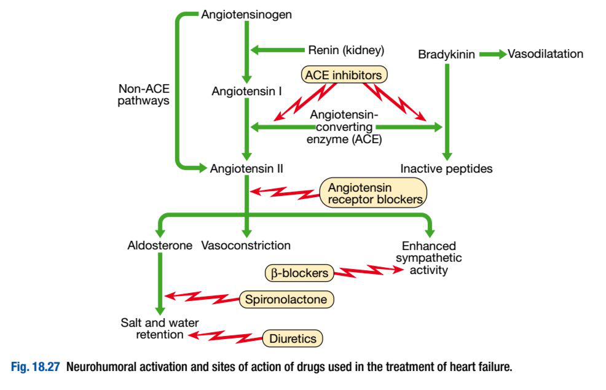

Slide 73
These drugs also prevent the undesirable activation of the renin–angiotensin system caused by diuretic therapy.
Whilst the major benefit of ACE inhibition in heart failure is a reduction in afterload, it also reduces preload and causes a modest rise in the plasma potassium concentrations.

Slide 74
Treatment with a combination of a loop diuretic and an ACE inhibitor therefore has many potential advantages.
In moderate and severe heart failure, ACE inhibitors can produce a substantial improvement in effort tolerance and in mortality.

Slide 75
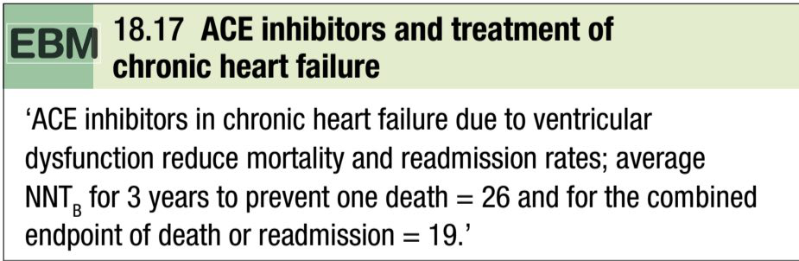
They can also improve outcome and prevent the onset of overt heart failure in patients with poor residual left ventricular function following MI

Slide 76
They can cause symptomatic hypotension and impairment of renal function, especially in patients with bilateral renal artery stenosis or those with pre-existing renal disease.
Short-acting ACE inhibitors can cause marked falls in BP, particularly in the elderly or when started in the presence of hypotension, hypovolaemia or hyponatraemia.

Slide 77
In stable patients without hypotension (systolic BP > 100mmHg), ACE inhibitors can usually be safely started in the community.

Slide 78
However, in other patients, it is usually advisable to withhold diuretics for 24 hours before starting treatment with a small dose of a long-acting agent, preferably given at night.
Renal function must be monitored and should be checked 1–2 weeks after starting therapy.

Slide 79
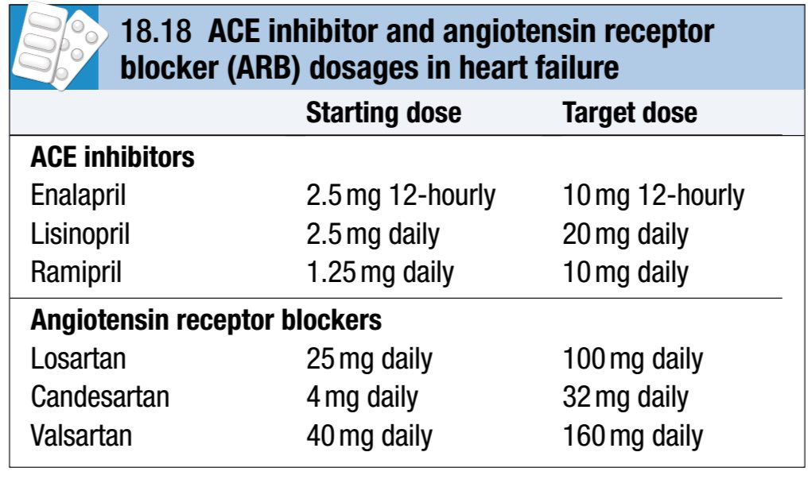

Slide 80
Angiotensin receptor blocker (ARB) therapy:
These drugs act by blocking the action of angiotensin II on the heart, peripheral vasculature and kidney.
In heart failure, they produce beneficial haemodynamic changes that are similar to the effects of ACE inhibitors but are generally better tolerated.

Slide 81
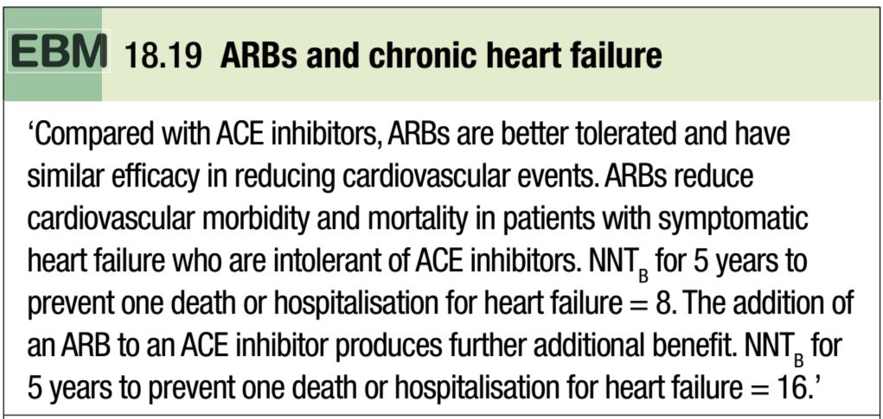
They have comparable effects on mortality and are a useful alternative for patients who cannot tolerate ACE inhibitors:

Slide 82
Unfortunately, they share all the more serious adverse effects of ACE inhibitors, including renal dysfunction and hyperkalaemia.
They may be considered in combination with ACE inhibitors, especially in those with recurrent hospitalisations for heart failure.

Slide 83
Beta-adrenoceptor blocker therapy:
Beta-blockade helps to counteract the deleterious effects of enhanced sympathetic stimulation and reduces the risk of arrhythmias and sudden death.

Slide 84
When initiated in standard doses, they may precipitate acute-on-chronic heart failure, but when given in small incremental doses (e.g. bisoprolol started at a dose of 1.25mg daily, and increased gradually over a 12-week period to a target maintenance dose of 10mg daily), they can increase ejection fraction, improve symptoms, reduce the frequency of hospitalisation and reduce mortality in patients with chronic heart failure.

Slide 85
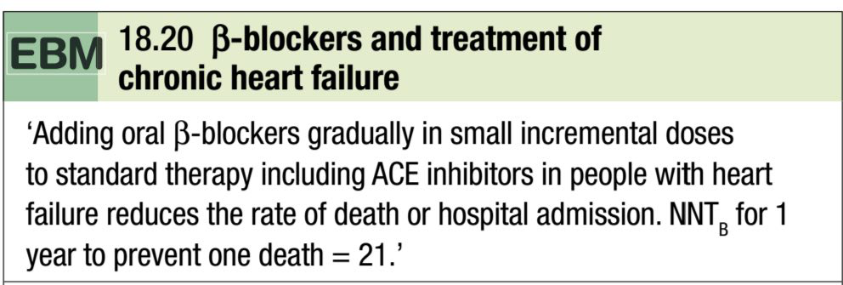
Beta-blockers are more effective at reducing mortality than ACE inhibitors: relative risk reduction of 33% versus 20% respectively.

Slide 86
Digoxin:
Digoxin can be used to provide rate control in patients with heart failure and atrial fibrillation.
In patients with severe heart failure (NYHA class III–IV), digoxin reduces the likelihood of hospitalisation for heart failure, although it has no effect on long-term survival.

Slide 87
Amiodarone:
This is a potent anti-arrhythmic drug that has little negative inotropic effect and may be valuable in patients with poor left ventricular function.
It is only effective in the treatment of symptomatic arrhythmias, and should not be used as a preventative agent in asymptomatic patients.

Slide 88
Implantable cardiac defibrillators :and resynchronisation therapy
Patients with symptomatic ventricular arrhythmias and heart failure have a very poor prognosis.
Irrespective of their response to anti-arrhythmic drug therapy, all should be considered for implantation of a cardiac defibrillator.

Slide 89
In patients with marked intraventricular conduction delay, prolonged depolarisation may lead to uncoordinated left ventricular contraction.

Slide 90
When this is associated with severe symptomatic heart failure, cardiac resynchronisation therapy should be considered.
Here, both the LV and RV are paced simultaneously in an attempt to generate a more coordinated left ventricular contraction and improve cardiac output.

Slide 91
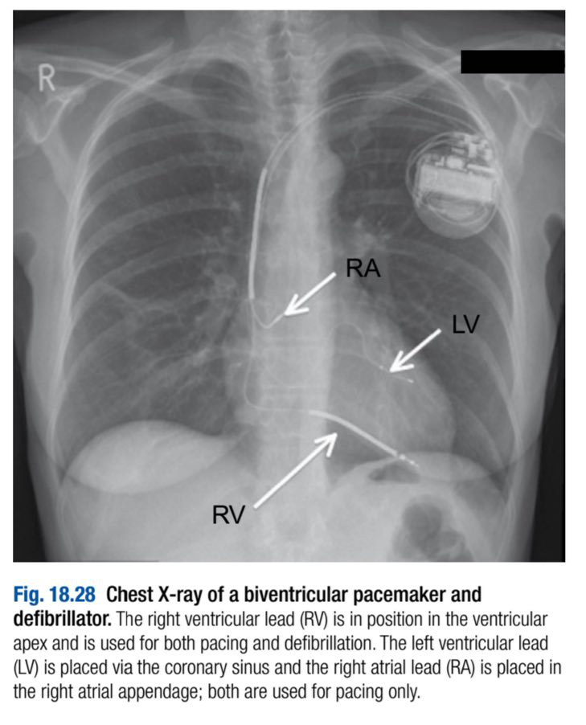

Slide 92
Coronary revascularisation:
Coronary artery bypass surgery or percutaneous coronary intervention may improve function in areas of the myocardium that are ‘hibernating’ because of inadequate blood supply, and can be used to treat carefully selected patients with heart failure and coronary artery disease. If necessary, ‘hibernating’ myocardium can be identified by stress echocardiography and specialised nuclear or MR imaging.

Slide 93
Heart transplantation:
Cardiac transplantation is an established and successful form of treatment for patients with intractable heart failure.
Coronary artery disease and dilated cardiomyopathy are the most common indications.

Slide 94
The introduction of ciclosporin for immunosuppression has improved survival, which is around 80% at 1 year.
The use of transplantation is limited by the efficacy of modern drug and device therapies, as well as the availability of donor hearts, so it is generally reserved for young patients with severe symptoms despite optimal therapy.

Slide 95
Conventional heart transplantation is contraindicated in patients with pulmonary vascular disease due to long-standing left heart failure, complex congenital heart disease (e.g. Eisenmenger’s syndrome) or primary pulmonary hypertension because the RV of the donor heart may fail in the face of high pulmonary vascular resistance.

Slide 96
However, heart-lung transplantation can be successful in patients with Eisenmenger’s syndrome.
Lung transplantation has been used for primary pulmonary hypertension.

Slide 97
Although cardiac transplantation usually produces a dramatic improvement in the recipient’s quality of life, serious complications may occur:
-Rejection: In spite of routine therapy with ciclosporin A, azathioprine and corticosteroids, episodes of rejection are common and may present with heart failure, arrhythmias or subtle ECG changes; cardiac biopsy is often used to confirm the diagnosis before starting treatment with high-dose corticosteroids.

Slide 98
-Accelerated atherosclerosis: Recurrent heart failure is often due to progressive atherosclerosis in the coronary arteries of the donor heart. This is not confined to patients who were transplanted for coronary artery disease and is probably a manifestation of chronic rejection. Angina is rare because the heart has been denervated.

Slide 99
-Infection: Opportunistic infection with organisms such as cytomegalovirus or Aspergillus remains a major cause of death in transplant recipients.

Slide 100
Ventricular assist devices:
Because of the limited supply of donor organs, ventricular assist devices (VADs) have been employed as:
- a bridge to cardiac transplantation
-potential long-term ‘destination’ therapy
-short-term restoration therapy following a potentially reversible insult such as viral myocarditis.

Slide 101
VADs assist cardiac output by using a roller, centrifugal or pulsatile pump that in some cases is implantable and portable.
They withdraw blood through cannulae inserted in the atria or ventricular apex and pump it into the pulmonary artery or aorta.

Slide 102
They are designed not only to unload the ventricles but also to provide support to the pulmonary and systemic circulations.
Their more widespread application is limited by high complication rates (haemorrhage, systemic embolism, infection, neurological and renal sequelae), although some improvements in survival and quality of life have been demonstrated in patients with severe heart failure.

Slide 103
